Slide 1
Artificial Intelligence

Slide 2
Lecture # 04
Uninformed Searching Algortihm

Slide 3
Today’s Lecture
Types of search Algorithms
Uninformed Search
Informed Search
Breadth-first searching
Depth-first search
Compare breadth first and depth first

Slide 4
Two main types of search
All search strategies are distinguished by the Order in which nodes are expanded
Uninformed search methods (Blind search) have access only to the problem definition.
Breadth-first search
Uniform-cost search
Depth-first search
Iterative deepening search
Bidirectional search
Informed search methods may have access to a heuristic function h(n) that estimate the cost of a solution from n.
Greedy best-first search
A* search
Recursive best-first search (RBFS) search

Slide 5
Uninformed Search
Sometimes we may not get much relevant information to solve a problem.
Suppose we lost our car key and we are not able to recall where we left, we have to search for the key with some information such as in which places we used to place it. It may be our pant pocket or may be the table drawer. If it is not there then we have to search the whole house to get it. The best solution would be to search in the places from the table to the wardrobe. Here we need to search blindly with less clue.
This type of search is called uninformed search or blind search.

Slide 6

Uninformed Search and Exploration
Blind search – BFS, DFS, uniform cost
no notion concept of the “right direction”
can only recognize goal once it’s achieved

Slide 7
Informed Search
We can solve the problem in an efficient manner if we have relevant information, clues or hints. The clues that help solve the problem constitute heuristic information.
Informed search is also called heuristic search.
Instead of searching one path or many paths just like that informed search uses the given heuristic information to decide whether or not to explore the current state further.

Slide 8
Informed Search
Add domain-specific information to select the best path along which to continue searching.
Define a heuristic function, h(n), that estimates the “goodness” of a node n.
Specifically, h(n) = estimated cost (or distance) of minimal cost path from n to a goal state.
The heuristic function is an estimate, based on domain-specific information that is computable from the current state description, of how close we are to a goal.

Slide 9
Breadth-first search
Breadth first search (BFS), as the name implies, searches from the initial state breadth-wise.
That is it searches all the states in the tree level by level.
Only after exploring all the states in one level it will jump to the next level.
Once the solution is found the search stops.
The breadth first search is guaranteed to find the solution if one exists.

Slide 10
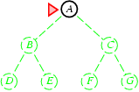
Breadth-first search
Expand shallowest unexpanded node
Implementation:

Slide 11
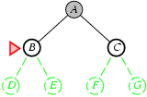
Breadth-first search
Expand shallowest unexpanded node
Implementation:

Slide 12
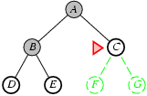
Breadth-first search
Expand shallowest unexpanded node
Implementation:

Slide 13
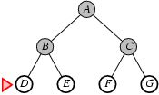
Breadth-first search
Expand shallowest unexpanded node

Slide 14
Breadth-first searching
A breadth-first search (BFS) explores nodes nearest the root before exploring nodes further away
For example, after searching A, then B, then C, the search proceeds with D, E, F, G
Node are explored in the order A B C D E F G H I J K L M N O P Q
J will be found before N
A
B
C
D
E
F
G
H
I
J
K
L
M
N
O
P
Q

Slide 15
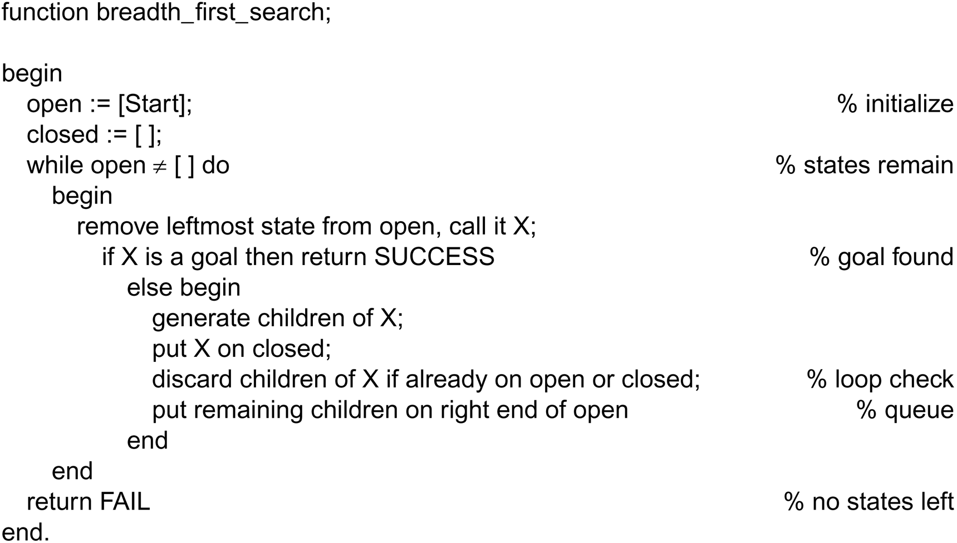
Breadth-first search algorithm
Nodes are lining up to be visited in open. closed keeps track of all the nodes visited already.

Slide 16
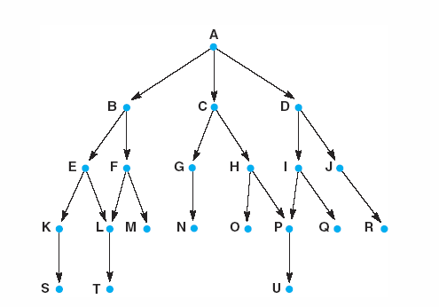
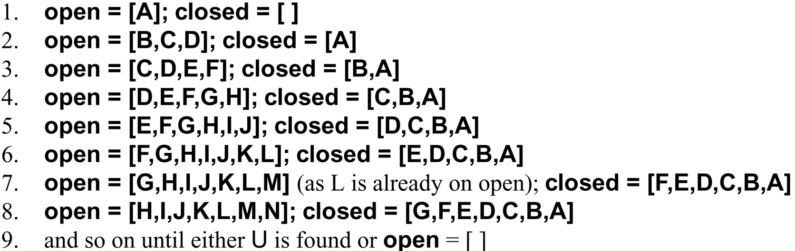
A trace of
breadth-first algorithm
B is not the goal. Put his children onto the queue. Put him in closed. He is done.
|
|
|
Items between red bars are siblings.
|
|
|
|
|
|
|
|
|
|
|
|
goal is reached or open is empty.

Slide 17
Properties of breadth-first search
Complete? Yes (if b is finite) i:e,b is branching factor
Time? 1+b+b²+b³+… +b^{d} = O(b^{d+1})
Space? O(b^{d+1}) (keeps every node in memory)
Optimal? Yes (if cost = 1 per step)
Space is the bigger problem (more than time)

Slide 18
Time and memory requirement in Breadth-first
Depth | Nodes | Time | Memory
0 | 1 | 1 millisec | 100 bytes
2 | 100 =10^2 | .1 sec | 11 Kb
4 | 10000 | 11 sec | 1 Mb
6 | 10⁶ | 18 minutes | 111 Mb
8 | 10⁸ | 31 hours | 11 Gb
10 | 10¹⁰ | 128 days | 1 Tb
12 | 10¹² | 35 years | 111 Tb
14 | 10¹⁴ | 3500 years | 11.111 Tb
Assume branching factor b=10; 1000 nodes explored/sec and 100 bytes/node

Slide 19
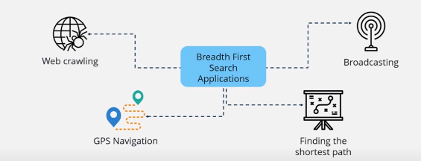
Applications

Slide 20
Depth-first search
Explore only one branch deeper till the solution is found or there is no new state to explore and then start searching the adjacent level.
This technique is called depth first searh (DFS).
By chance the solution exists in the first branch then depth first search can find the solution quickly.
If the solution exists in some other branches farther away, there won't be much difference between depth first search and breadth first search

Slide 21
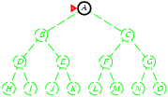
Depth-first search
Expand deepest unexpanded node
Implementation:

Slide 22
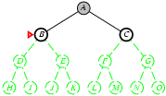
Depth-first search
Expand deepest unexpanded node
Implementation:

Slide 23
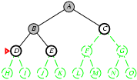
Depth-first search
Expand deepest unexpanded node
Implementation:

Slide 24
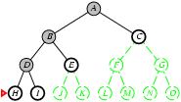
Depth-first search
Expand deepest unexpanded node
Implementation:

Slide 25
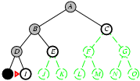
Depth-first search
Expand deepest unexpanded node
Implementation:

Slide 26
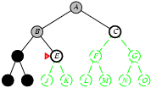
Depth-first search
Expand deepest unexpanded node
Implementation:

Slide 27
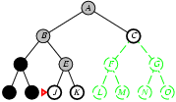
Depth-first search
Expand deepest unexpanded node
Implementation:

Slide 28
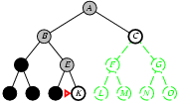
Depth-first search
Expand deepest unexpanded node
Implementation:

Slide 29
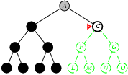
Depth-first search
Expand deepest unexpanded node
Implementation:

Slide 30
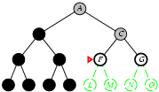
Depth-first search
Expand deepest unexpanded node
Implementation:

Slide 31
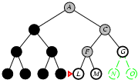
Depth-first search
Expand deepest unexpanded node
Implementation:

Slide 32
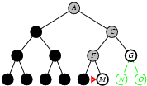
Depth-first search
Expand deepest unexpanded node
Implementation:

Slide 33
Depth-first searching
A depth-first search (DFS) explores a path all the way to a leaf before backtracking and exploring another path
For example, after searching A, then B, then D, the search backtracks and tries another path from B
Node are explored in the order A B D E H L M N I O P C F G J K Q
N will be found before J
A
B
C
D
E
F
G
H
I
J
K
L
M
N
O
P
Q

Slide 34
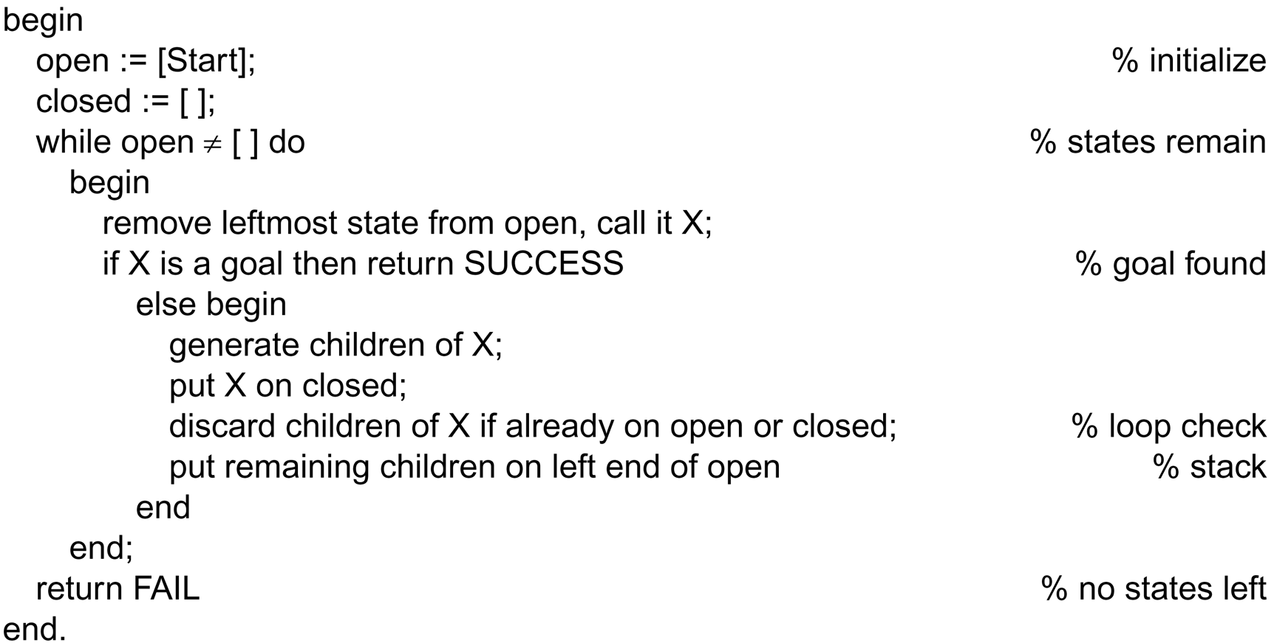
The depth-first search algorithm
This is the only difference between
depth-first and breadth-first.

Slide 35
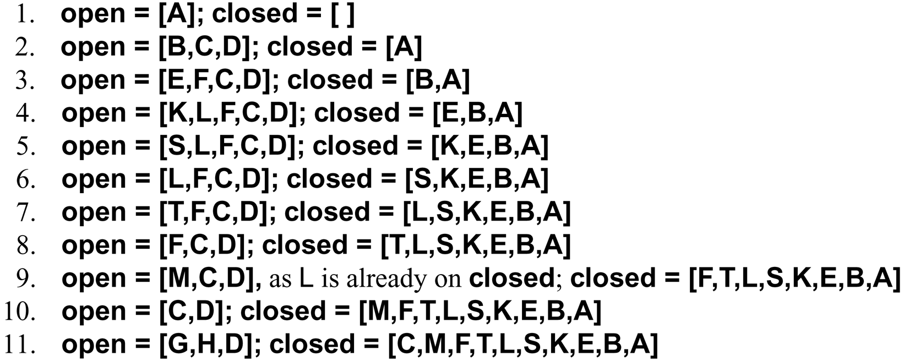
A trace of
depth-first algorithm
top of stack

Slide 36
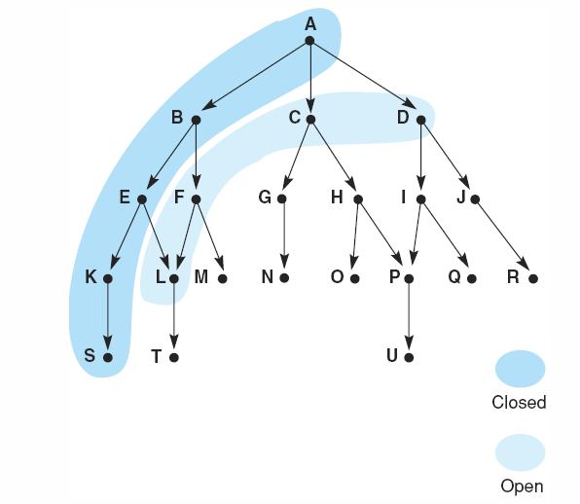
Snap shot at iteration 6
frontier
visited

Slide 37
Properties of depth-first search
Complete? No: fails in infinite-depth spaces, spaces with loops
Modify to avoid repeated states along path
→ complete in finite spaces
Time? O(b^{m}): where m is maximum depth of any node
terrible if m is much larger than d
but if solutions are dense, may be much faster than breadth-first
Space? For a state space with branching factor b and maximum depth m, depth-first search requires storage of only O(bm) nodes.
Optimal? N0.

Slide 38
Depth First Complexity
Let b: is the branching factor
Let d: maximum depth to find solution
So, the maximum number of nodes expanded before finding a solution at level “m”, it is :
1+b+b+b+….+b (m times)
Memory need = b*d
Complexity in worst case = O(b^{d}) as “Breadth-First”
Complexity in best case = O(b*d) which is excellent!

Slide 39
Time and memory requirement in Depth-first
Depth | Nodes | Time (best case) | Memory
0 | 1 | 1 millisec | 100 bytes
2 | 20 | 0.02 sec | 2 Kb
4 | 40 | 0.04 sec | 4 Kb
6 | 10 *6(b*d) | 0.06 sec | 6 Kb
8 | 10 * 8 | 0.08 sec | 8 Kb
10 | 10 *10 | 0.1 sec | 10 Kb
12 | 10 * 12 | 0.12 sec | 12 Kb
14 | 10 * 14 | 0.14 sec | 14 Kb
Assume branching factor b=10; 1000 nodes explored/sec and 100 bytes/node

Slide 40
Comparing the ordering of search sequences
Determine the order of nodes (states) to be examined
Breadth-first search
When a state is examined, all of its children are examined, one after another
Explore the search space in a level-by-level fashion
Depth-first search
When a state is examined, all of its children and their descendants are examined before any of its siblings
Go deeper into the search space where possible

Slide 41
BFS vs DFS
DFS finds the goal by traversing all the nodes in the finite space but in the infinite space, it will probably not find the goal.
If the graph is sparse and large, and the nodes are far apart, DFS may be more efficient than BFS.
If the memory is limited and the time is flexible, DFS may be more preferable than BFS.

Slide 42
BFS vs DFS
BFS first checks the nearest nodes. the bfs could solve the problem not only in the finite space but also on infinite space. therefore it is a complete algorithm. the time needed to run BFS is O(b^d).
The problem with BFS is that it uses so much memory space because it must keep all the boundary nodes in memory
On the other hand, if the problem requires finding the shortest path or the closest node, BFS may be more suitable than DFS.

Slide 43
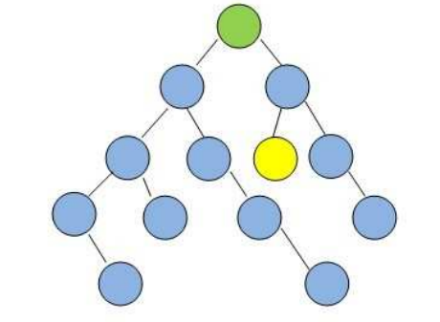
Example
In the following graphs, assume that if there is ever a choice amongst multiple nodes, both the BFS and DFS algorithms will choose the left-most node first.
Starting from the green node at the top, which algorithm will visit the least number of nodes before visiting the yellow goal node?

Slide 44
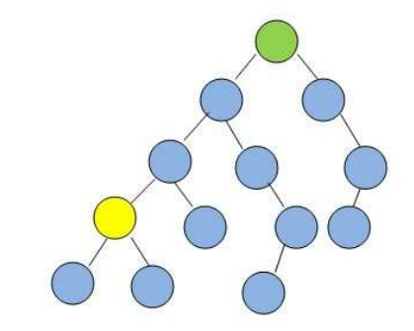
Example
In the following graphs, assume that if there is ever a choice amongst multiple nodes, both the BFS and DFS algorithms will choose the left-most node first.
Starting from the green node at the top, which algorithm will visit the least number of nodes before visiting the yellow goal node?

Slide 45
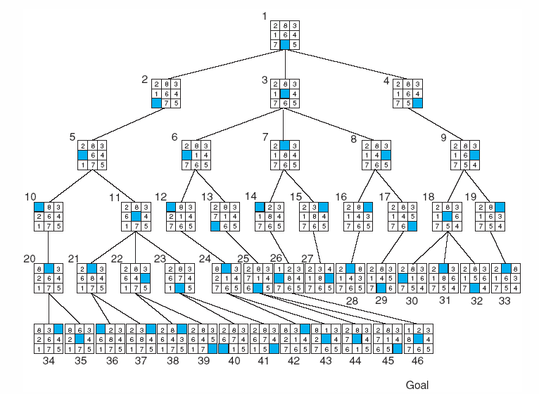
Breadth-first search of the 8-puzzle
←
↑
→
↓
Cannot move
blank downward
↑
Notes:
For larger versions of the n-puzzle, finding a solution is easy, but the problem of finding the shortest solution is NP-hard

Slide 46
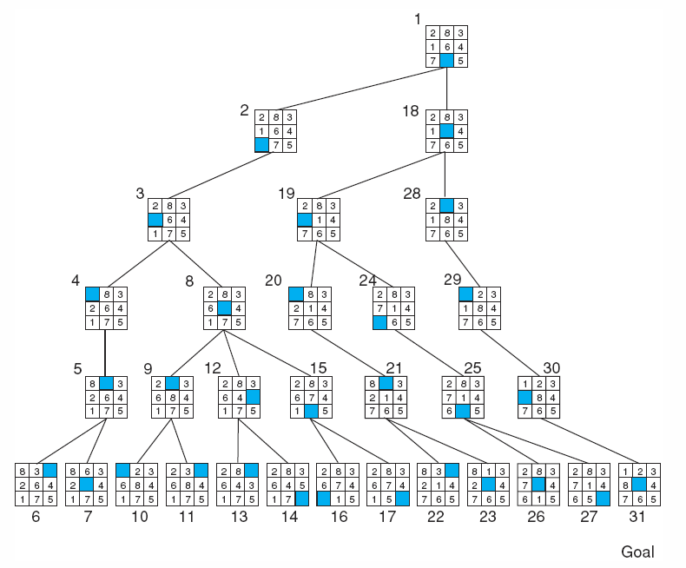
Depth-first search of 8-puzzle
with a depth bound of 5
Breadth-first
took
46 nodes.

Slide 47
Summery of Today’s Lecture
Types of search Algorithms
Uninformed Search
Informed Search
Breadth-first searching
Depth-first search
Compare breadth first and depth first

